Slide 1

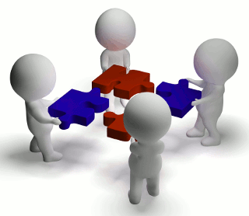
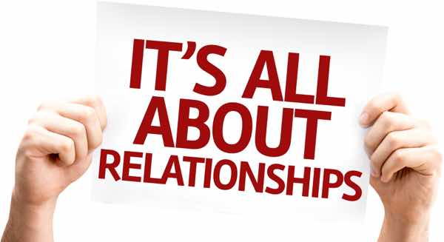
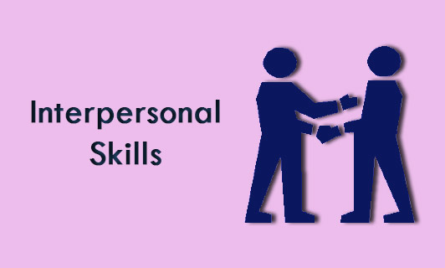
_
Interpersonal Skills in the Workplace

Slide 2
_
Picture this: You are in a meeting at work with 20 of your colleagues and it's not a good meeting because productivity has been down and targets have not been met….you blame your lazy co workers…you blame your partner for not supporting and you even blame the lunch lady because she took two minutes extra of your time which you could be using to work…but you do not blame yourself…WHY??? Because you know how to deal with every personality in your office and those around you.So what are you missing? Have any of you ever found yourself in this situation before…sound familiar?
Is because there are so many different personalities we work with everyday and we often don’t realise how this impacts our work.
We need to ensure our interpersonal skills are up to scratch to be our best.

Slide 3
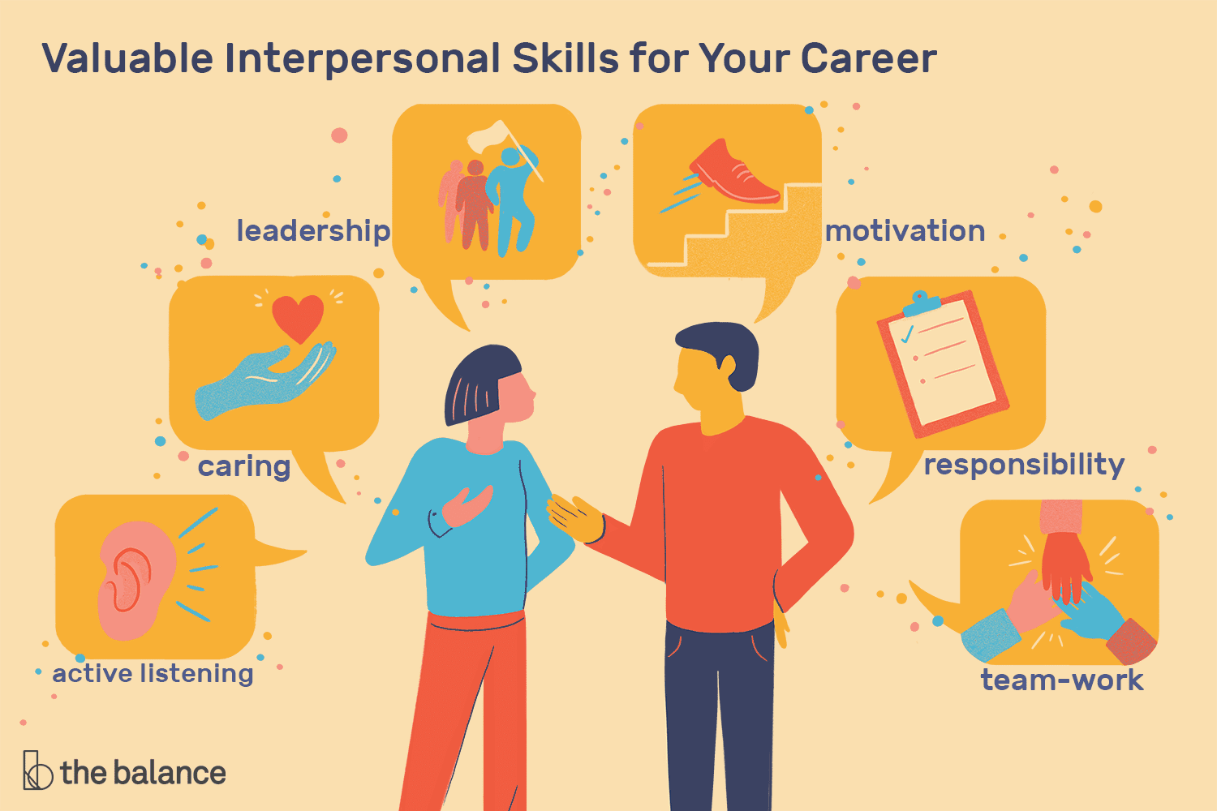

_
What are Interpersonal Skills and Why are they Important
Simply put, it is the social skills of interaction and communication with others.It is how employees get along with each other.
They are important because it shapes our attitudes, skills, knowledge and expertise through the management of our emotions in a work environment so we can build positive and productive relationships.Good interpersonal skills are also required for recruitment opportunities.

Slide 4
_
Impact of Interpersonal Skills
A lack of these critical skills affect the business as below:
Poor decision making
Loss of situational awareness
Errors of Judgment
Confusion

Slide 5
_
Some ways to apply these skills at work
Courtesy | Professional Dress | Punctuality | Speech
Some ways to apply these skills at work:Greet co workers when they walk by your deskAddress by name whenever you can(‘not hey’) Don’t interrupt | Dress clean and neat no matter what the dress code is.Don’t let your clothes speak for you-let your performance make the impression | Arrive on time Meet deadlines | Do not gossip

Slide 6
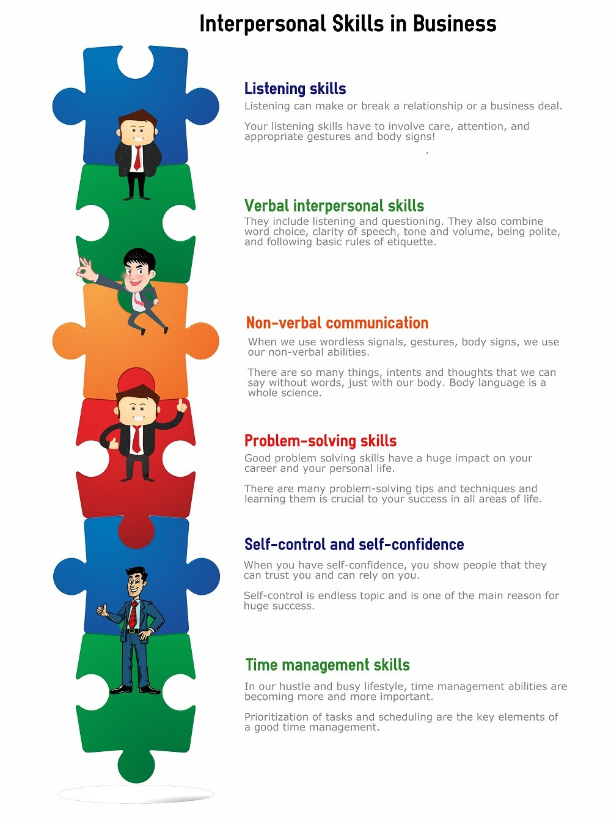
_

Slide 7
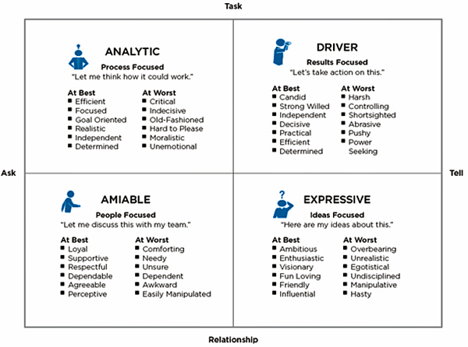
_
Social Styles
“Social Styles” is the name of a particular psychometric instrument that helps people to better understand and work with others through appreciation of their basic decision making and control needs.Developed by Chase Woodford he goes on to say there are four distinct social styles that we each can fall into.

Slide 8
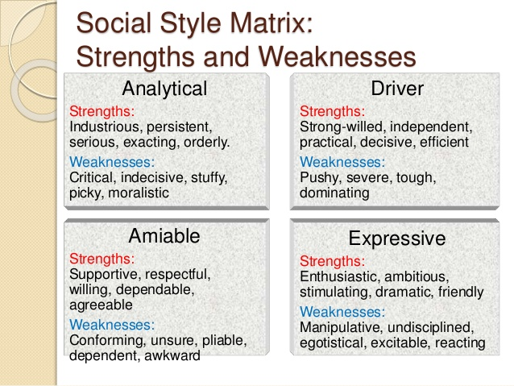
_
Please take a few minutes to complete the quiz
to find out your Social Style

Slide 9
_
For the purpose of our workshop today we will focus on five critical interpersonal skills we all deal with on a constant basis during our work environment,we will learn how to:
Dealing with Office Politics
Handling difficult conversations
Building Rapport
Communicating across cultures
How to be an Active Listener

Slide 10
_
Dealing with office politics
A co worker begins complaining about someone you like and respect,what do you say?
You don’t have to agree or disagree.You can be diplomatic.We use certain expressions to convey our response in a more indirect way
(Refer to Handout,Marked Script)

Slide 11
_
Accepting a point | Declining to speak | Suggest an alternative
There’s possibly some truth to that | Necessarily the right person to comment on that | I don’t think that’s entirely the case /I don’t think that’s entirely the case. Well maybe we should look at

Slide 12
_
Handling difficult conversations
Grace is a personnel manager at a logistics company. Leo is a long-time employee who always arrives late to the office. His supervisor has asked Grace to talk to him, to try to change his behavior.What might be challenging about this conversation? How should Grace handle the conversation, to ensure a positive outcome? Below are the ways you would handle a difficult conversation
Analyze the problem | Maintain professionalism | Have actionable objectives
Define what the issue is from your perspective, and then find out what the other person’s perspective is. | Avoid discussing other staff’s behavior unless it’s part of the problem Be clear about the issue, but approach it as a problem that can be solved by working together. | Make sure to set clear goals, a timeline, and way to measure results.

Slide 13
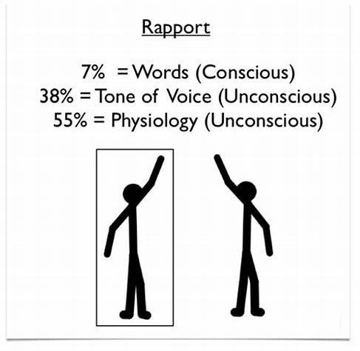
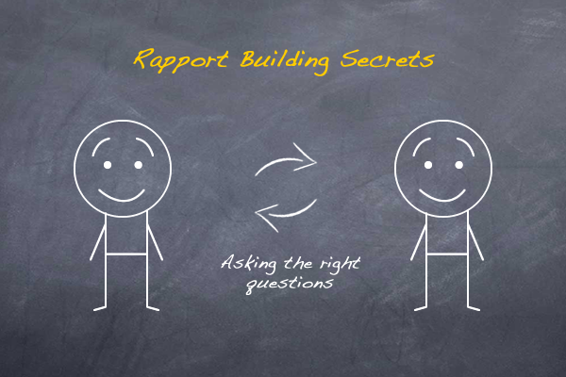
_
Building Rapport
You are at a conference on business and during a lunch break you meet some new people.
How do experts do well at networking:
Meet and greet new people?
Make a good impression with small talk?
Ask for a professional favor?

Slide 14
_
We can build rapport by Reading and using body language What does good body language look like? Consider the points below, and think of some good and bad examples for each. Handshakes Eye contact Shoulders, arms and where you put your hands when you are talking
Building rapport with questions Compare the questions below. Which is better for building rapport and why? ‘How many years have you been doing your job?’ ‘What’s the most interesting thing about your job?’ Asking for something Compare these two ways of asking for something. Which one do you think is more effective and why? ‘I’m looking for new opportunities to move forward in my career. Are there any positions available in your team at the moment, suitable to my skills?’ ‘I think I might want to change jobs soon. How are things in your team these days?’

Slide 15
_
Communicating across cultures
When networking with people from different cultures that we are not familiar with we may cause unintended offense , some of these are listed below: 1. ... misunderstandings are easy to deal with; business is business. 2. ... you can predict their behavior by the country they come from. 3. ... awkward conversations are common. Miss Wang and Mr. Zhang(who are Chinese) are having a business dinner with Mr. Jeffries, who is British. These are some problem that may occur because of cultural differences. Misunderstandings due to language barrier Different food taste Different ideas about doing business, due to cultural differences.

Slide 16
_
Using assumptions positively There can be negative and positive assumptions as shown below: 1. I heard that Shandong is famous for being very friendly. 2. Chinese companies are really great at copying others' designs 3. New Zealand has some beautiful scenery; do you enjoy outdoor hobbies? 4. American people are always so outgoing and confident 5. Chinese people are good with numbers Clearing up Misunderstandings 1.To ask politely if you are not sure about something 2.Do not assume 3.Do not generalize using your preconceived notions about the other persons culture Steering a conversation 1.Taking control of the conversation to avoid potential offense and can possibly insult your guest 2.Do it indirectly 3.For example a person mentions something they assumed about your culture,politely say:’ I guess we have spoken alot about my culture,let's change the subject to something more exciting like….”

Slide 17
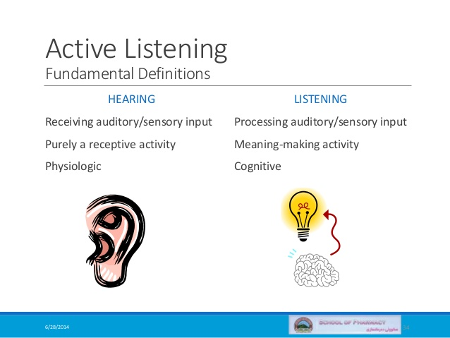
_
Active Listening
One of the most important skills when it comes to interpersonal skills is to be able to actively listen.
It a skill that can be acquired and developed with practice. However, active listening can be difficult to master and will, therefore, take time and patience to develop.
'Active listening' means, as its name suggests, actively listening.You listen for meaning and is considered critical to prevent misunderstandings or getting your signals crossed.

Slide 18



